Slide 1
SIA Executive Roundtable
December 1, 2016

Slide 2
The Gig Economy: It’s big and it’s growing
“If 2015 was the tipping point for the contingent workforce’s growth and evolution,
2016 is the year that the ‘gig economy’ propels it to new heights.”
- Ardent Partners, The State of Contingent Workforce Management 2016-2017: Adapting to a New World of Work
Notes:
The business world is changing. They way work is addressed and the way work is done have been transformed.
Across the world, the traditional notions of labor, work and talent are being altered. As global competition for market share increases, executives need new, more adaptive strategies to propel their companies to the next level of performance.
The winners will be agile organizations increasingly reliant on non-employee talent. The emergence of the ‘gig economy’ – with its capabilities for on-demand staffing and access to real-time talent – is both a reflection and a driver of this new world of work.

Slide 3
Three Numbers to Remember
44 Million
people took on Gig Work in the US
of US workers did Gig Work in 2015
total 2015 US Gig Economy Spending
29%
$792 Billion
Notes:
As of May 2015, 15.5 million people in the U.S. were self-employed, according to the Bureau of Labor Statistics-an increase of roughly 1million since May 2014. That number is expected to keep growing at a steady clip.
By 2020, a study by Intuit and Emergent Research estimates that more than 40% of the American workforce, or 60 million people, will be independent workers—a combination of freelancers, contractors, and temporary employees.
A third study** reports that last year 24% of U.S. adults (59 million) used online platforms to make money – either through digital sales, or rentals, or the performance of services. That is consistent with what SIA describes as the ”Human Cloud”.
*Intuit 2020 (with Emergent Research)
**Pew Research Center 2016

Slide 4
Why is this happening now?
TALENT
DEMAND
“Project-based work has become more attractive
Social contract guaranteeing job security and plush benefits is dead or dying
Today’s technology makes it easy to plug in
- Harvard Business Review
TECHNOLOGY
Notes:
Why is this happening now?
Largely due to three converging forces—Talent, Demand and Technology
Demand for talent creating new pressures
Supply of talent changing behavior/decision making
Advances in technology enabling new models
As the Harvard Business Review noted in a 2012 article, companies follow talent. So as growing numbers of professionals decide that they prefer to work
on a temporary basis, organizations are finding ways to work with them.
“The prevalence of lean management teams, the post-recession drive to cap costs, and the accelerating pace of change combine to make temporary solutions compelling.”
“In a global business climate that puts a premium on companies’ ability to test ideas and change course on a dime—knowing how best to engage this lower-risk, flexible, and faster talent model can be a source of competitive advantage.”

Slide 5
About OnForce
HISTORY
Founded in 2004
In 2014 OnForce became a division of Beeline and a strategic and independently operated business unit of Adecco Group, the world’s leading provider of HR solutions.
LOCATION
Headquartered in Lexington, MA
ABOUT
We are dedicated to connecting companies with best-fit professionals, and enabling both parties to manage every aspect of an engagement, all on one platform.
Allows companies to search for, negotiate with, and engage directly with non-employee talent
TRACK RECORD
3.5M
10,000
Extensive coverage across U.S. and Canada
ASSIGNMENTS COMPLETED
TALENTED PROFESSIONALS

Slide 6
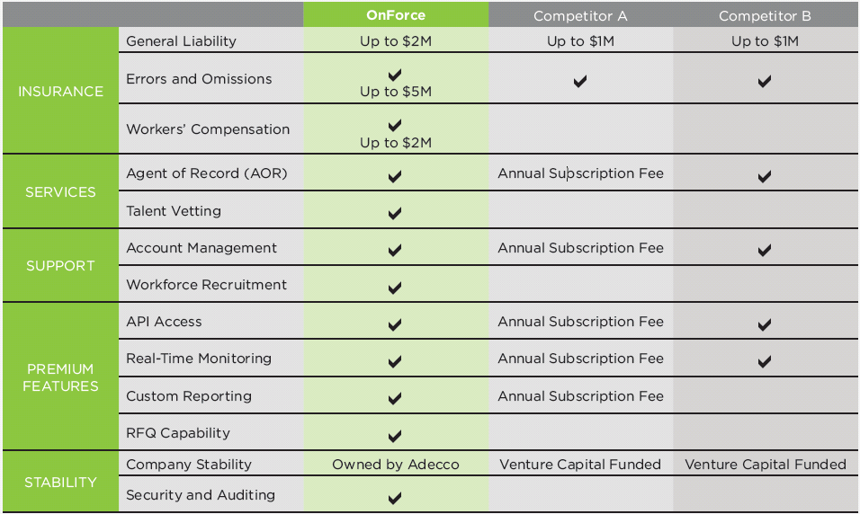
The OnForce Difference
Notes:
Premium features include – custom fields, custom reporting, bundling

