Slide 1
THE SEI WAY
The Values and Practices of a Performance Driven Company

Slide 2
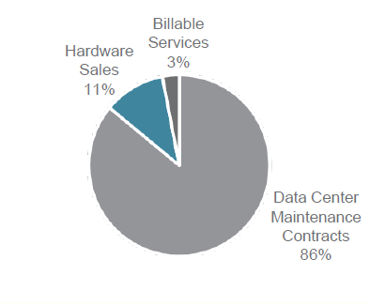
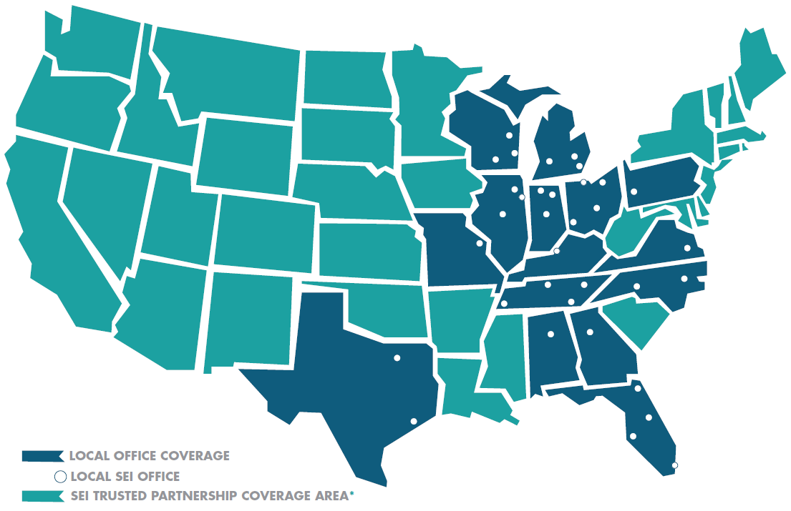
SEI OVERVIEW
Since 1986, Service Express, Inc. (SEI) has been delivering exceptional on-site hardware maintenance support for mission critical servers, storage and networking equipment. SEI is one of the leaders in third-party maintenance (TPM), a growing market for post-warranty hardware support.
Service Offerings
The Majority of SEI’s business is contractually recurring from data center maintenance agreements.
Geographic Footprint
SEI operates a network of 34 offices in 15 states and employs over 300 people.

Slide 3
Zig Ziglar
“You can get everything you want in life if you just help enough other people get what they want.”
Notes:
⁽¹⁾ Projected is adjusted quarterly based on rolling 24 month results and based on years of service

Slide 4
Notes:
⁽¹⁾ Projected is adjusted quarterly based on rolling 24 month results and based on years of service

Slide 5
Notes:
⁽¹⁾ Projected is adjusted quarterly based on rolling 24 month results and based on years of service

Slide 6
SR5
Performance Management Systems
Scorecards
ROIs
5/15s
Scorecards – Key Performance Indicators at global, department, regional & office levels
ROIs – Responsibilities, Objectives, and Indicators – measurable job descriptions for every employee
5/15s – Quarterly list of priority goals & projects

Slide 7
X
Systems = Value
Notes:
⁽¹⁾ Projected is adjusted quarterly based on rolling 24 month results and based on years of service

Slide 8
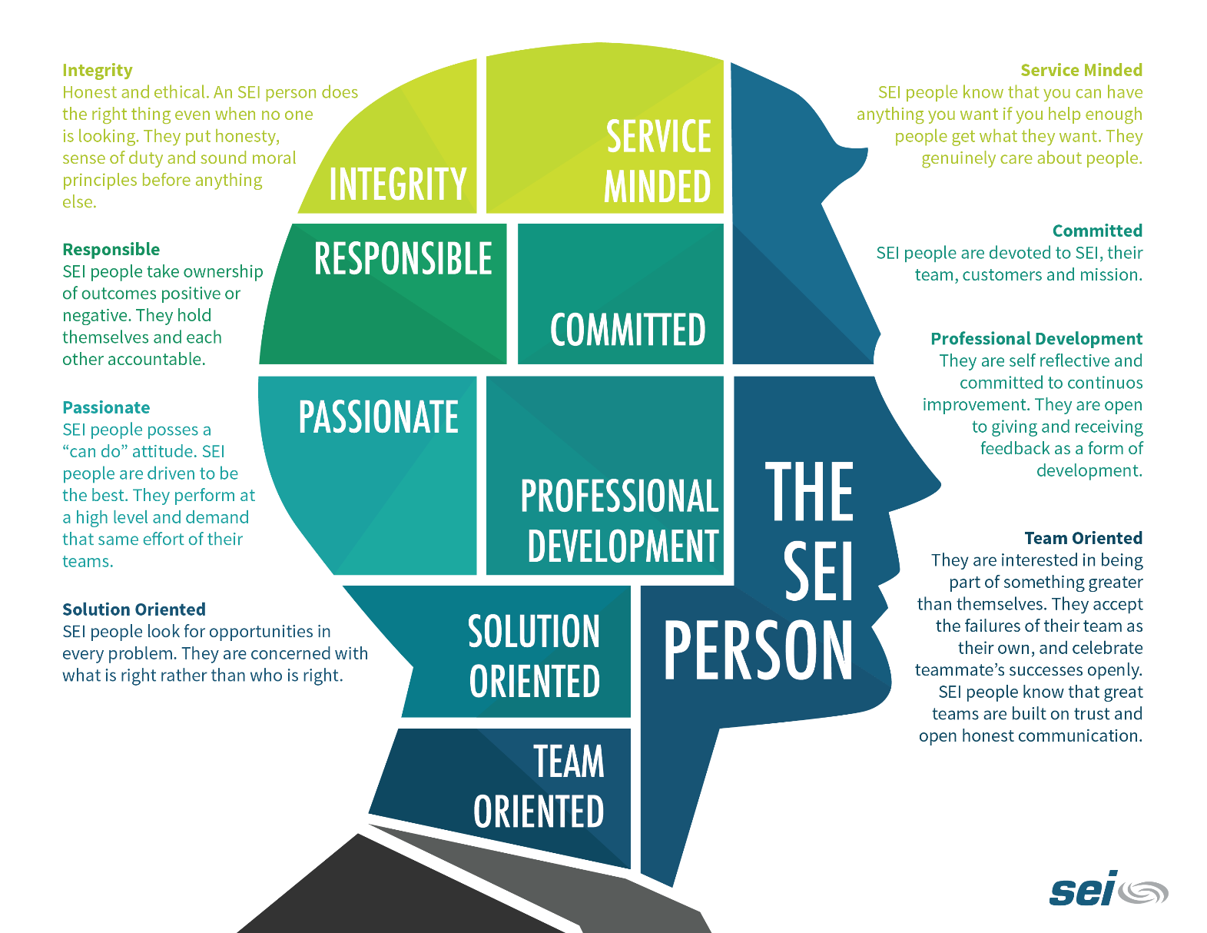
The SEI Person
Notes:
⁽¹⁾ Projected is adjusted quarterly based on rolling 24 month results and based on years of service

Slide 9
The SEI Leader
Notes:
⁽¹⁾ Projected is adjusted quarterly based on rolling 24 month results and based on years of service

Slide 10
Employee Engagement
Communication
Belief
Significance
Arranger
Responsibility
Notes:
⁽¹⁾ Projected is adjusted quarterly based on rolling 24 month results and based on years of service

Slide 11
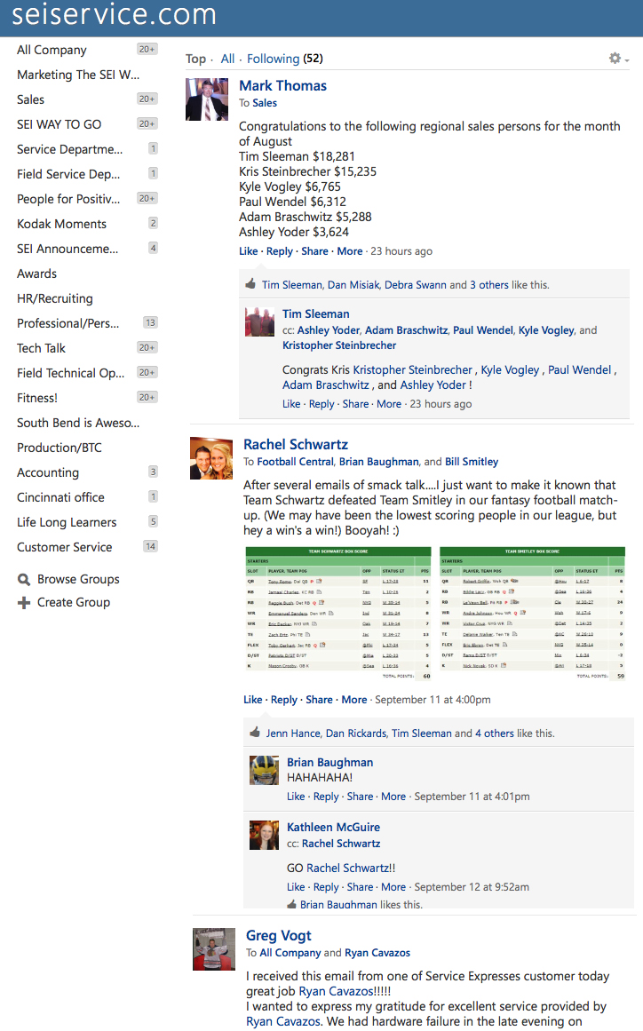
Employee Engagement
Notes:
⁽¹⁾ Projected is adjusted quarterly based on rolling 24 month results and based on years of service

Slide 12
SEI REVENUE
(Projected)
Notes:
⁽¹⁾ Projected is adjusted quarterly based on rolling 24 month results and based on years of service

Slide 13
Net Promoter Score
“On a scale of 1-10, would you recommend SEI to a friend or colleague”?
80

Slide 14
Net Promoter Score
Additional Questions Asked
Question 1: My dedicated Account Executive stays in touch and communicates with me appropriately.
93% Agree / Strongly Agree
Question 2: I am impressed with the technical skill of my Field Engineer.
96% Agree / Strongly Agree
Question 3: In my experience, SEI has the parts available for my equipment.
97% Agree / Strongly Agree

Slide 15
Employee Engagement
 | 2014 | 2012 | 2011
Employee Engagement and Commitment | 91.3 | 89.8 | 89.0
Community Initiatives | 88.8 | 84.8 | 82.8
The Job | 87.5 | 87.4 | 86.6
Culture | 87.2 | 87.2 | 86.6
Diversity and Multiculturalism | 86.9 | 86.6 | 85.4
Direct Manager | 86.7 | 86.9 | 84.5
Employee Education and Development | 85.5 | 85.2 | 84.2
Recognition and Retention | 84.9 | 84.8 | 84.1
Leadership | 83.1 | 84.5 | 83.8
Teamwork and Cooperation | 82.8 | 86.1 | 85.5
Communication | 81.6 | 82.5 | 81.7
Work / Life Balance | 80.1 | 81.8 | 80.4
Recruitment and Selection | 79.9 | 81.1 | 80.9
Compensation and Benefits | 73.6 | 74.8 | 75.6
SEI Employee Engagement Survey | 84.3 | 84.5 | 83.5
Response Rate | 90% | 98% | 99%
Notes:
⁽¹⁾ Projected is adjusted quarterly based on rolling 24 month results and based on years of service

Slide 16
SERVICE EXPRESS, INC.
For More Information
Download The SEI Way eBook at
www.seiservice.com
or visit
www.ronalvesteffer.com
Facebook.com/ronalvesteffer
Twitter.com/ronalvesteffer
Linkedin.com/in/ronalvesteffer.com

